Slide 1

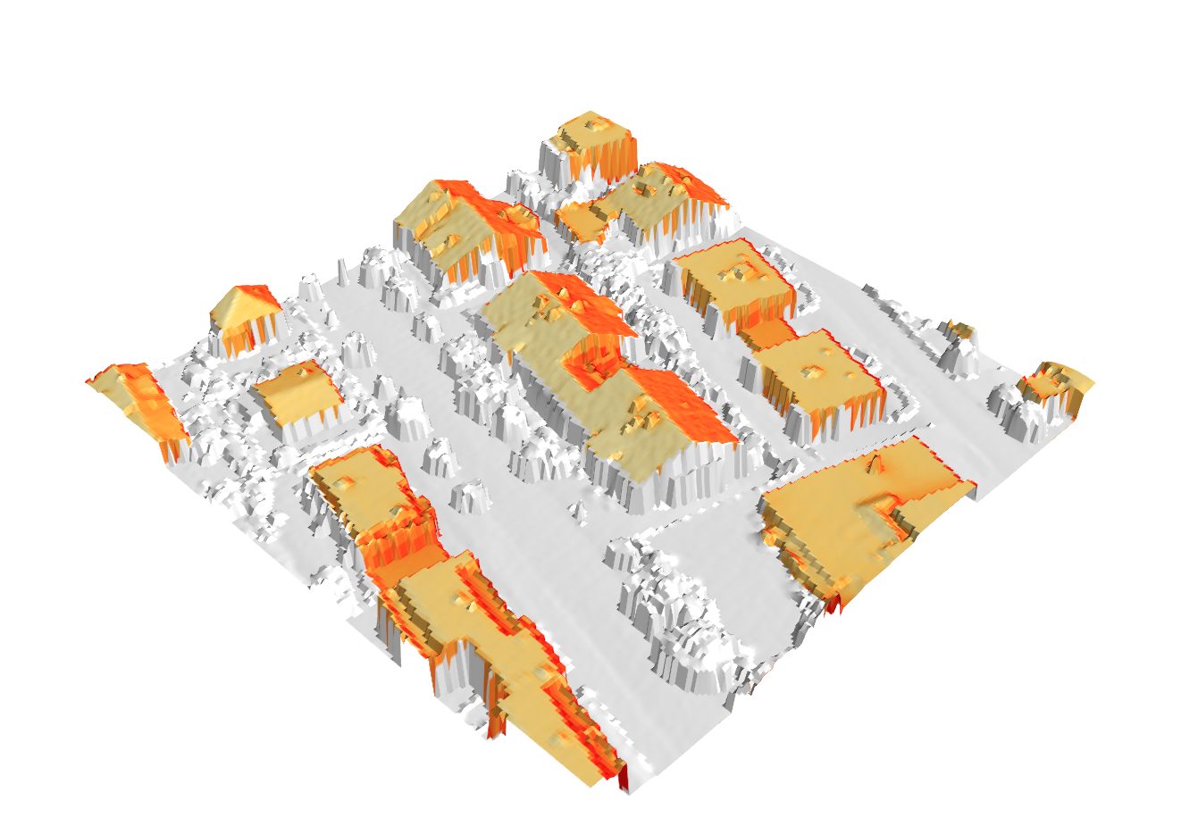
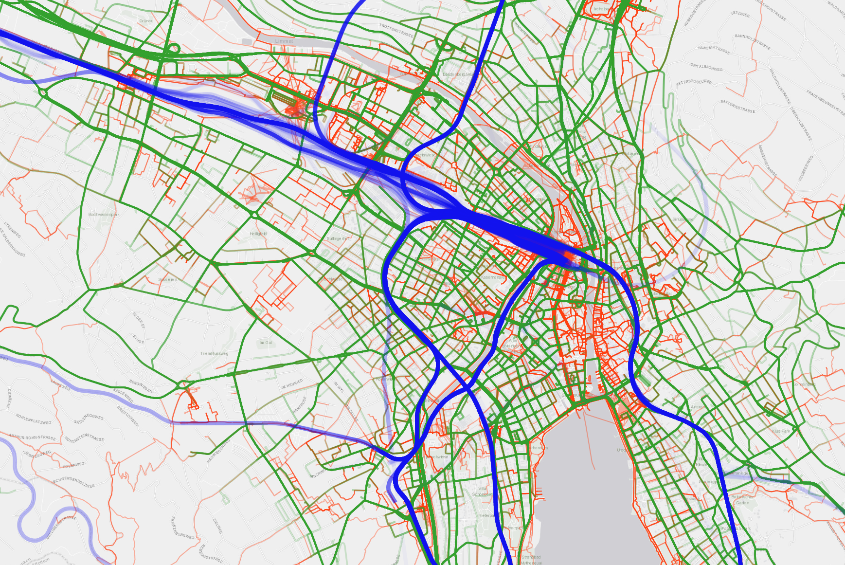



The Potential of Residential Rooftop Photovoltaic Energy to Charge Electric Cars for Daily Use
Henry Martin, René Buffat, Dominik Bucher, Martin Raubal
The transport sector is responsible for 36% of the Swiss total annual energy demand. If the transport sector is electrified, significant additional power production capabilities are required. Photovoltaic (PV) energy is the renewable energy source with the highest remaining potential in Switzerland. However, due to its fluctuating power production, it is unclear how PV can contribute to fuel electric vehicles (EV). In this work, we analyze how much rooftop PV on homes of electric vehicle owners can contribute to cover the energy demand of their vehicles. In our analysis, we combine a spatio-temporal PV rooftop model with trajectories of electric vehicles and sensor information from the cars’ batteries.
Input data
Figure 1: Photovoltaic potential on rooftops [1]
Figure 2: Map-matched movement trajectories of study participants
Figure 3: Power consumption as a function of change in state of charge
Results
Figure 4: Trajectory data based classification of the EV locations and their charging states for one week in June
Figure 5: PV coverage potential of all users of our study
Using a PV rooftop model covering the whole of Switzerland (Fig. 1) [1], we compute the potential PV power production on the roofs of the homes of the 90 EV owners of our sample. Combining this with their movement trajectory data (Fig. 2) and the battery state of charge (SoC) recorded by the EVs (cf. Fig. 4), we can determine the total charging demand by applying the power consumption function (Fig. 3) whenever a users car is at his or her home location and is not fully charged. Putting the resulting power demand into relation with the PV production gives an assessment of how much of the power demand could be covered by on-site PV production. Figure 5 shows the potential percentage of PV energy coverage considering that the users’ roofs are completely covered by PV panels. Our analysis shows that the users of our study can cover in average 66.7% of their home charging demand using PV. For future work, we plan to simulate energy demands more accurately and incorporate hypothetical batteries at users’ homes.
[1] R. Buffat, S. Grassi, and M. Raubal. "A scalable method for estimating rooftop solar irradiation potential over large regions." Applied Energy 216 (2018): 389-401.
This research is part of the activities of the Swiss Centre for Competence in Energy Research on the Future Swiss Electrical Infrastructure (SCCER-FURIES) and the Swiss Centre for Competence in Energy Research Mobility (SCCER Mobility), which are financially supported by the Swiss Innovation Agency (Innosuisse - SCCER program).

